Slide 1
Vincent MARTINAUD
Legal Manager
IBM France
IBM CONFIDENTIAL

Slide 2
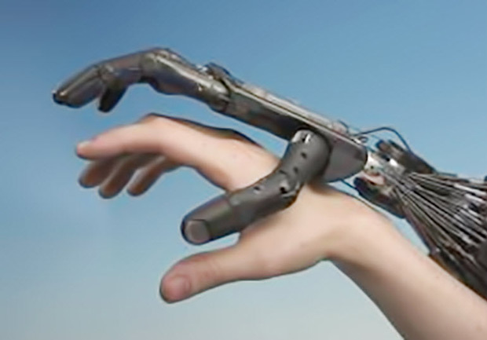
Artificial Intelligence: an operational perspective
AI: why now?
Where are we with AI?
Use Cases for Lawyers
IBM CONFIDENTIAL
Source: http://www.zdnet.fr/i/edit/ne/2017/05/artificial-intelligence-leg.jpg

Slide 3
1. AI: why now?
Easier access to big data
Technologies
Investments
IBM CONFIDENTIAL
Source: https://transformation-digitale.pwc.fr/sites/default/files/styles/blog_large/public/intellignece_artificielle_0.jpg?itok=GnyeCCsL

Slide 4
BIG DATA
TECHNOLOGIES
INVESTMENTS
Around 5 quintillion (10 to the power of 18) bytes of data created every year
= 8 billion people receiving 340 newspapers each day
90 % of available data in the world created these last 2 years
Double effect:
Fast development of AI (fed by data)
Focus on AI as a powerful ally in the management of information
Blockchain: the more information you get, the more you need to be confident about its authenticity
Quantum Computing
Double effect:
AI needs these tech to develop itself, and
AI will be needed to harness all these tech advances
For 2017, the estimated investment in AI was of EUR 380 billions
EC Communication April 2018
Specific focus on some areas: autonomous cars, health sector, gaming industry
Source: http://www.vie-publique.fr/focus/IMG/jpg/stockage-donnees-une.jpg
IBM CONFIDENTIAL
Source: https://encrypted-tbn0.gstatic.com/images?q=tbn:ANd9GcRCvfj9rDs9sdCEloAFNwtltkq6HYAvh8wS0AGFbaXYvi9KVxNr
Source: http://2.bp.blogspot.com/-kys-hH5aR-U/VC9RDRgDUsI/AAAAAAAACiI/P0Kx_hKnkuU/s1600/Technologie.jpg

Slide 5
Where are we with AI?
6 levels of AI
What does AI promise?
IBM CONFIDENTIAL
Source: http://fr.sott.net/image/s17/355717/full/intelligence_artificielle.jpg

Slide 6
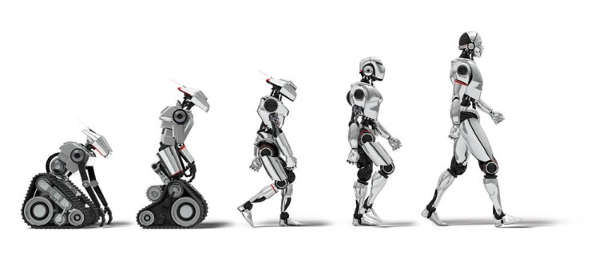
2. Where are we with AI today?
Ultimate artificial intelligence (uniqueness)
6 levels of AI*
http://www.reporteroindustrial.com/documenta/imagenes/126754/xinteligencia-artificial-industria-g.jpg.pagespeed.ic.rmx6AXARnA.jpg
Above all humans for a majority of tasks (AGI)
Above all humans for specific tasks
Above most humans for specific tasks
Equal to humans for specific tasks
Below humans for specific tasks
* Source: Professor JC Heudin, CNEJITA 2018 Conference
Source: https://www.groupezebra.com/wp-content/uploads/2016/08/intelligence-artificielle.jpg
IBM CONFIDENTIAL

Slide 7
2. Where are we with AI today?
What is the promise of A.I.?
Better, quicker decisions
And savings!
“Organizations that analyse relevant data and deliver actionable information could achieve an extra $430 billion in productivity gains over less analytically oriented peers by 2020” (IDC)
Intelligence vs capacity to calculate or to store information
IBM CONFIDENTIAL
Source: https://1.bp.blogspot.com/-3vag8rc0XZY/V7nATkNT14I/AAAAAAAAApU/SvM_CapL2NcP4jwFg69RyZrDUEEsAoingCLcB/s1600/pile%2B%25C3%25A0%2Blire%2B4.jpg

Slide 8
3. Use Cases for Lawyers
4 categories of AI applications:
Due diligence and Legal Research [Bots / ROSS]
Document and Contract Review [Juvenile Court dashboard / OCI]
Contract or Memo Drafting [Argumentor / ASCCIM]
Insights and Predictions [HR cases]
6 examples:
A constellation of capabilities (overlap)
Programmed vs trained (machine learning)
Many “AI” applications
Source: https://cdn-images-1.medium.com/max/1000/1*oiOEh2oy3pq9DnMaD_N9Og.jpeg
IBM CONFIDENTIAL

Slide 9
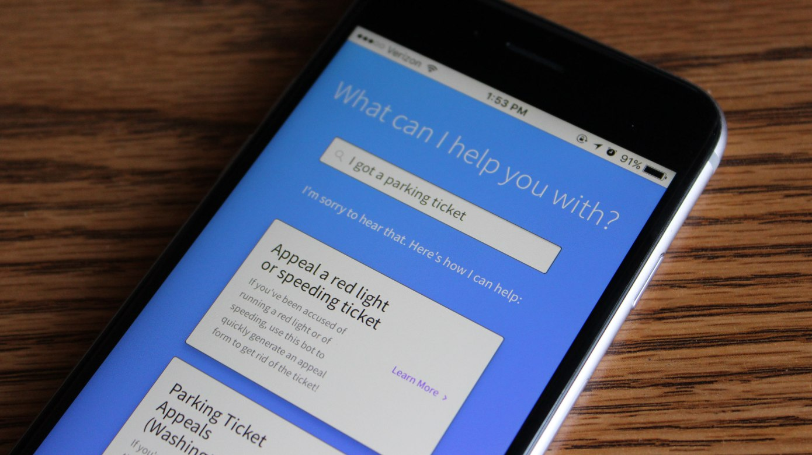
Do Not pay
A consumer advocacy chatbot
UK-born student Joshua Browder
Initially opposing parking tickets
Developed into other areas (maternity leave, landlord contracts)
Uses Watson technology for natural language
March this year: DoNotPay’s flight and hotel price protection service
Source: https://techcrunch.com/wp-content/uploads/2017/07/donotpay-ios.jpg?w=1390&crop=1
IBM CONFIDENTIAL

Slide 10
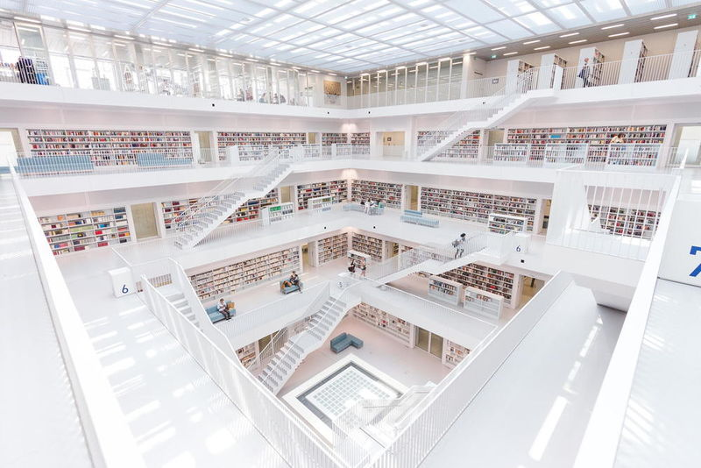
ROSS
More than a chatbot: helps lawyers find relevant cases using natural language search
Questions asked in plain English as you would a colleague
ROSS can understand the context of a query
Law firm BakerHostetler: bankruptcy practice
Source: https://cdn.trendhunterstatic.com/thumbs/powered-by-ross.jpeg
IBM CONFIDENTIAL

Slide 11
Always more information from various sources
Always less time to handle always more cases:
- 30 to 35 cases on the docket
- About 6 minutes to spend for each of them
With 30 to 300 pages to read!
A dashboard of cloud-based information that can be updated in real-time by any court officer with:
- A summary of a child’s situation
- The most recent and past drug history
- Their current situation in terms of education and living arrangement – etc.
Hey Watson: Local judge first to use IBM’s artificial intelligence on juvenile cases**
* Source: http://www.mydaytondailynews.com/news/local/hey-watson-local-judge-first-use-ibm-artificial-intelligence-juvenile-cases/InVqz6eeNxvFsMVAe5zrbL/
Source: Chris Stewart / Staff https://www.mydaytondailynews.com/rf/image_medium/Pub/p8/MyDaytonDailyNews/2017/08/03/Images/newsEngin.19446536_ddn080317capizziwatson058.jpg
IBM CONFIDENTIAL

Slide 12
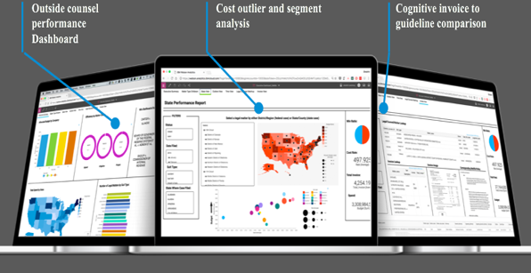
OCI
Structured and unstructured data in Legal invoices
OCI reads this unstructured data, understanding language as people do
Benefits:
- Reduces OC spend - $392M savings for a FSS company
- Helps OC
Source: https://cdn-images-1.medium.com/max/1600/1*8rnFmbwfLd54ZjQC_MzafA.png
IBM CONFIDENTIAL

Slide 13
Argumentor:
- Not only locates the right law or case law, but most of all
- Builds strong arguments and anticipates counter arguments
ASCCIM:
- Reads and analyzes tender documents
- Issues a report on identified legal issues
Argumentor
/
ASCCIM
Source: CSA Images/ Color Printstock
Collection/Hayon Thapaliya/Getty Images
IBM CONFIDENTIAL

Slide 14
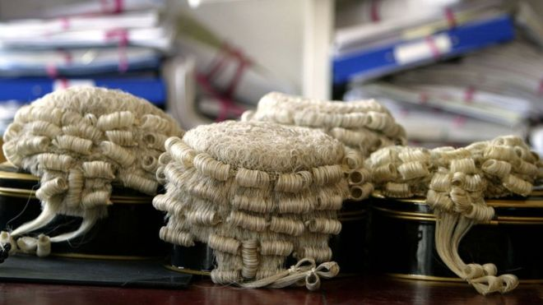
AI application was used by a team of UK and US researchers to predict the outcomes of hundreds of Human rights cases
The AI predicted the verdicts to an accuracy of 79%, according to the scientists involved
Errors when similar facts for different outcomes
Source: Source: http://www.bbc.com/news/technology-37727387
https://ichef-1.bbci.co.uk/news/660/cpsprodpb/DBCE/production/_89707265_lawgeneric2.jpg
IBM CONFIDENTIAL

Slide 15
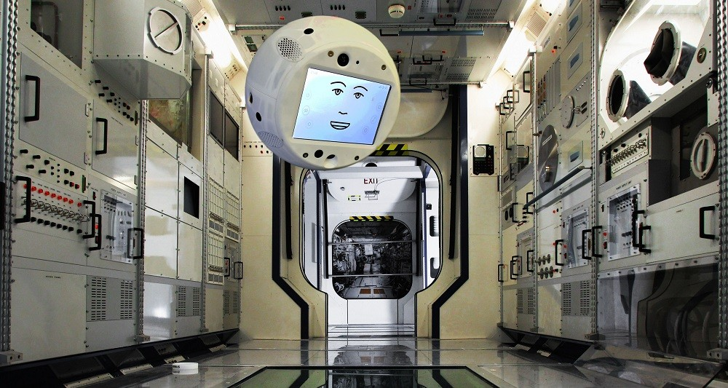
CIMON
"Crew Interactive MObile CompanioN"
A ball-sized device currently being developed by Airbus, using IBM’s Watson technology
Designed to help the astronauts perform several tasks (incl. the conduct and filming of a medical experiment (more than 100 steps)
Source: https://www.lesechos.fr/intelligence-artificielle/veille-technologique/0301381847009-cimon-un-droide-pour-la-station-spatiale-internationale-2159102.php
IBM CONFIDENTIAL

Slide 16
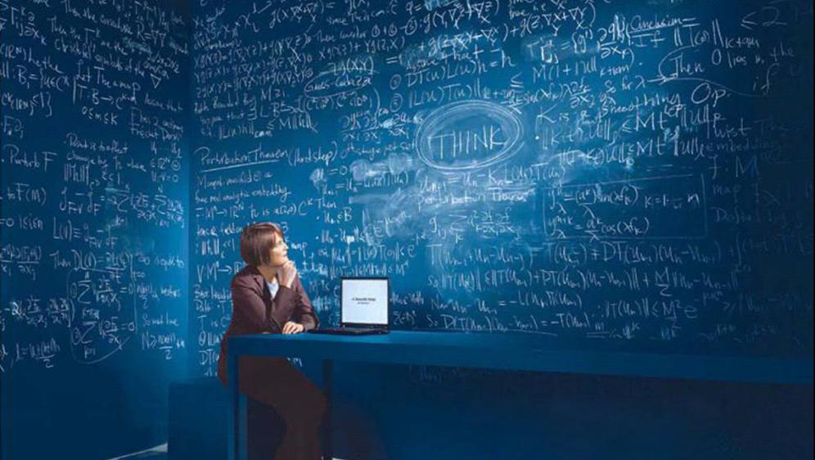
Thank You
IBM CONFIDENTIAL

